Slide 1
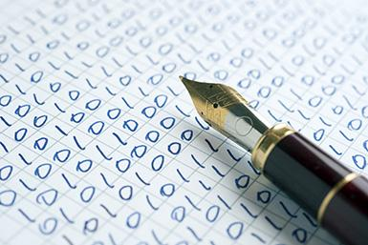
Negotiating Sustainability
Lisa Goddard
@lisagoddard
AUL Digital Scholarship & Strategy
University of Victoria Libraries
Notes:
New initiative called the “Grants Menu”. A key impetus for developing the grants menu was increased researcher demands for the long term preservation of digital projects.

Slide 2
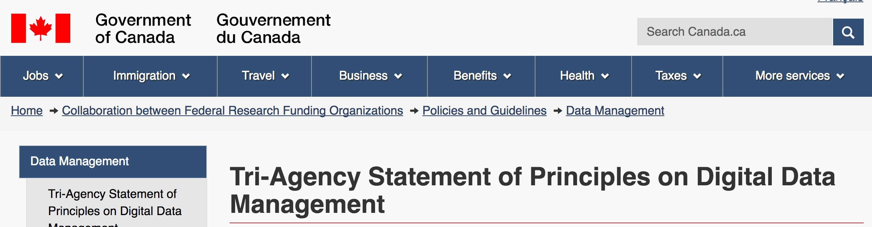
Responsibilities of research institutions include:
providing their researchers with an environment that enables world class data stewardship practices;
supporting access to…platforms that securely preserve, curate and provide continued access to research data;
providing their researchers with guidance to properly manage their data…including the development of data management plans;
Notes:
That demand is driven in part by funding agency mandates that require researchers to articulate their sustainability plans within the funding application.
But also a reflection of the fact that researchers dedicate huge amounts of time and energy to their projects, and they want that work to be available in 5-10 years.
http://www.science.gc.ca/eic/site/063.nsf/eng/h_83F7624E.html

Slide 3
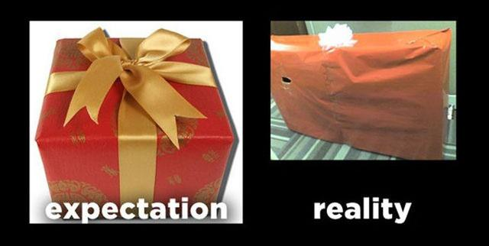
Expectation Gap
Notes:
However, researchers often have very high expectations about what the library can deliver. While we appreciate your faith in our ability, sometimes these expectations are not realistic.
Faculty often show up at the end of a funding cycle, when all of the money has been spent, with a complex stack of software, and the expectation that the library can adopt the project and keep it running in perpetuity. For most academic libraries this is not a scalable proposition.

Slide 4
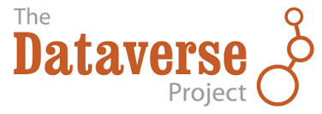
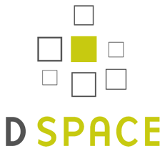

Digital Object Repositories
Notes:
Digital preservation in libraries usually begins with collections of research objects that are held in our local repositories.

Slide 5
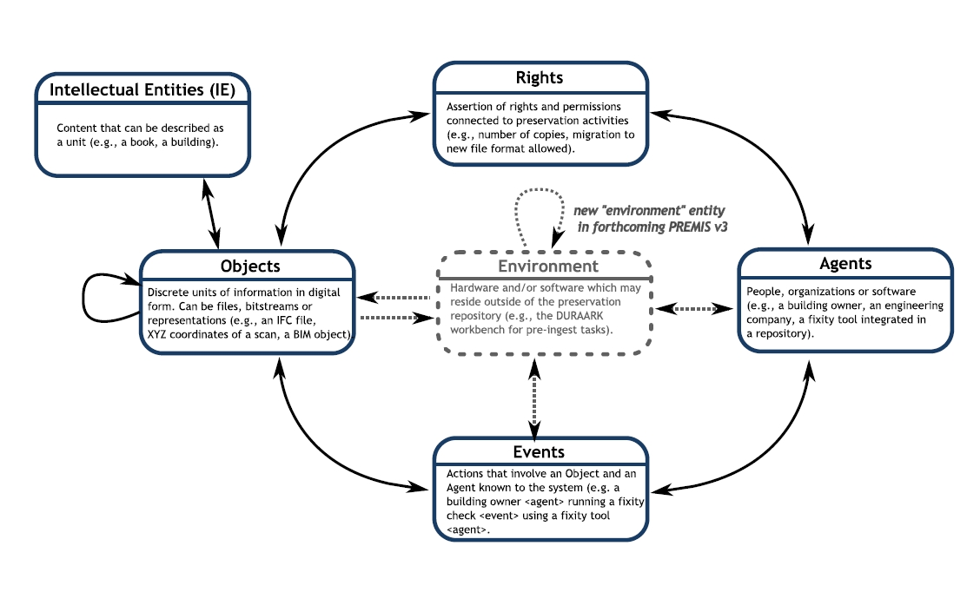
PREMIS Preservation Metadata
Notes:
Those repositories include standardized, interoperable metadata schemas that contain all of the information needed to manage a file over time including information about encoding, checksums, rights, etc.
Libraries have long preservation horizons. In 25 years no one from the original project will be around to provide information, so it’s important to capture it as objects are created.

Slide 6
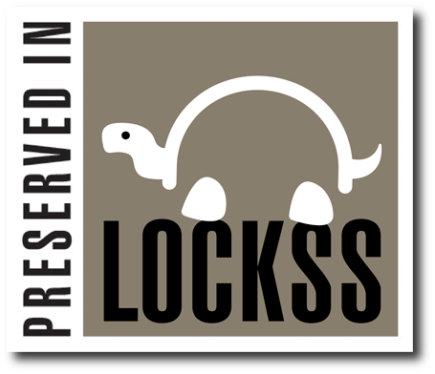

Preservation Storage
Notes:
Libraries have also started to develop distributed preservation storage networks. All of these are dark archives, though.
We can zip up your files and put them into deep storage, but is that a good use of resources if people can’t find them or use them?

Slide 7
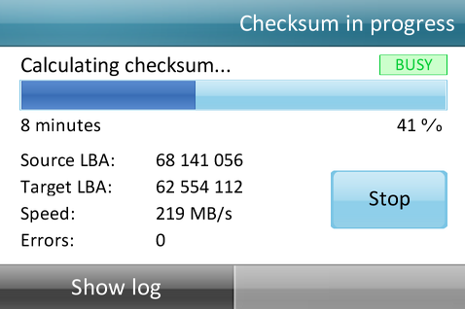
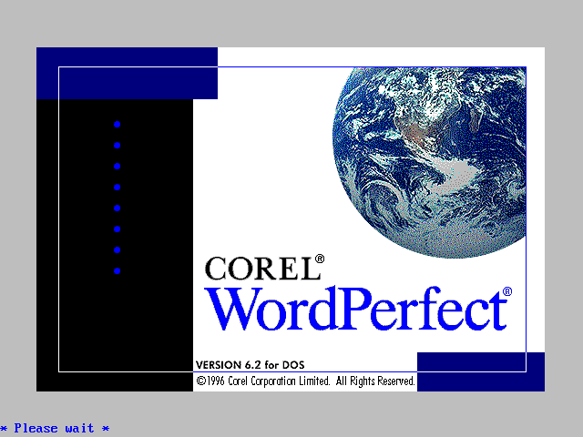

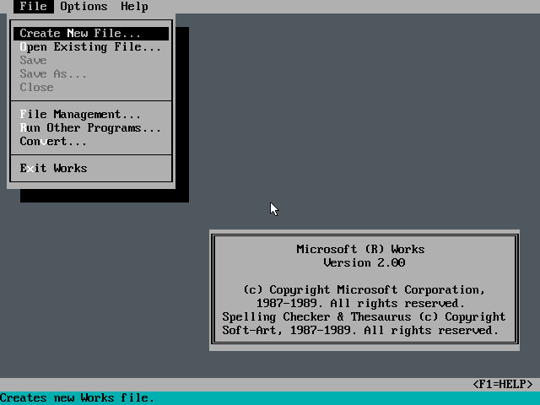
Active Preservation
File fixity & integrity
Format migration
Notes:
Digital Preservation is active and ongoing. In the analog world we would preserve something by keeping it exactly the same. Manuscripts can be better preserved if we don’t touch them or use them.
Digital objects are more likely to survive if they are actively used, opened, checked and migrated to new formats over time. A lot of ongoing work is involved in digital preservation.

Slide 8
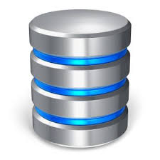



Preservation Funding
Notes:
Storage and tools and expertise all cost money. Funding agencies have not been forthcoming with new money to support their data management mandates. Universities are juggling a lot of competing demands for money. Library budgets are shrinking relative to journal costs. How can we scale and sustain digital preservation activities.

Slide 9
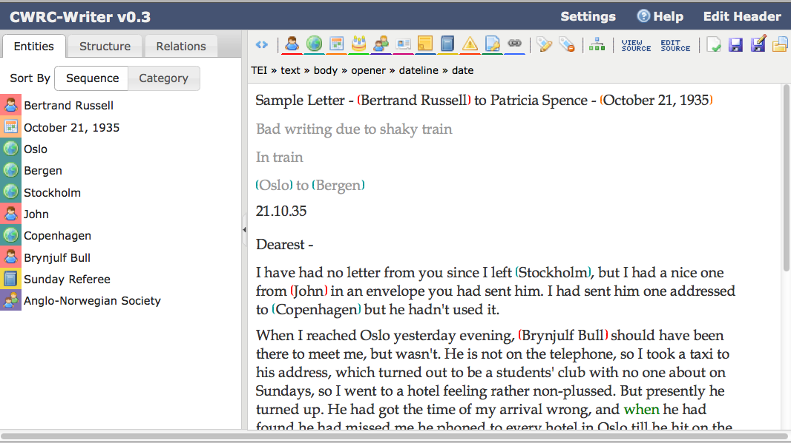
Complex Applications
List of named entities.
Add relationship.
Notes:
A complicating factor with DH projects is the fact that they are usually more than just collections of objects. They are complex stacks of software tools that require constant maintenance, patches, and upgrades. Most libraries are completely unprepared to maintain large numbers of diverse software applications over the long term.

Slide 10
The Fundamental Tension
Freedom of Choice
Sustainability
Notes:
There is a strong inverse correlation between total freedom of choice and sustainability.
This tension is at the crux of negotiations between the researchers who create a project, and the librarians who must maintain it in perpetuity.

Slide 11
Early Intervention
Start the conversation at the beginning of a project.
Clarify what is possible.
Help faculty to understand how their choices will impact sustainability.
Notes:
Sustainability is something that has to be built into project design from the beginning. If the library will be the preservation partner, then they need to be involved in early conversations about tool and design choices.
There are many good reasons that researchers many choose not to align with library preservation models, but these conversations can allow researchers to understand the impact of those choices.

Slide 12
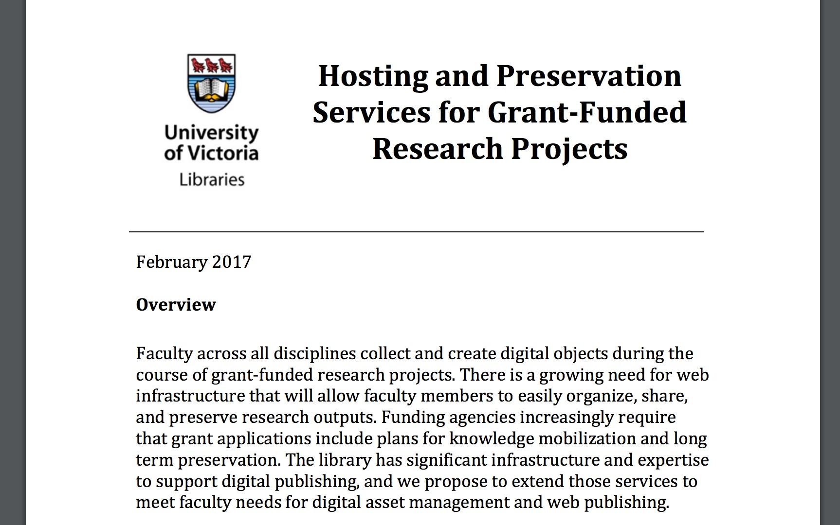
“Grants Menu”
http://tiny.cc/uvicgrants
Notes:
Grants menu is an a la carte offering of different library services that can support faculty grant applications, with a particular focus on digital preservation.
For each item we provide a description, along with the in-kind value of that service to a funded project. In this way researchers not only get a sense of what is possible, they can easily imagine how this partnership could help to strengthen their funding application.

Slide 13
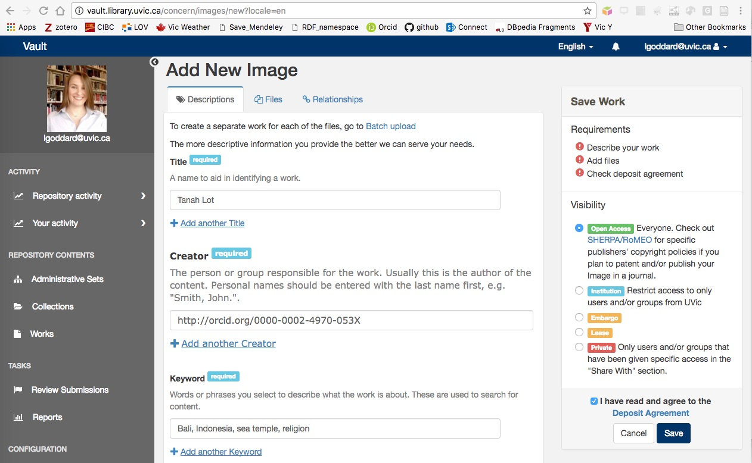
Digital Asset Management
Notes:
Libraries have mature software platforms that are designed to manage digital research objects. This includes metadata entry forms, file versioning, access control for the research team, ability to share objects publicly, along with standard backups and platform maintenance.
Many projects build their own versions of software to handle these tasks. Using the library systems could save time and money, and let you focus on your actual research question.

Slide 14
Hydra Digital Asset Management
In-kind value:
$1250/yr ($50 x 25 hrs) for collection configuration, training, and support.
$250/yr for infrastructure costs & maintenance.
Additional feature development and support at cost.
Notes:
Not only will this save you money, but it can add in-kind contributions that strengthen a funding application.

Slide 15

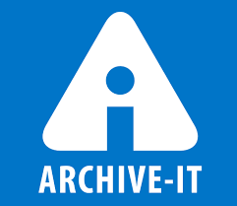
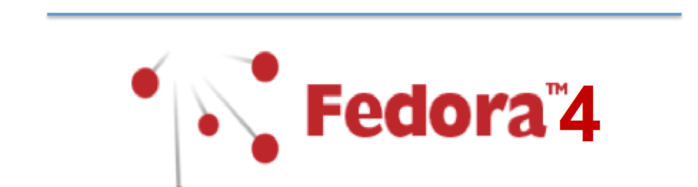

Digital Preservation
Notes:
Another advantage of using our digital asset management systems, is that they are already connected to preservation and storage systems. Your research objects will automatically become part of the library’s preservation workflow.

Slide 16
Digital Preservation
Cost (not in-kind):
• $2,594/TB one-time payment for long term storage costs
• $500/funded year for ongoing preservation services
Additional storage space available at cost.
Notes:
In the grants menu we do ask researchers to make a contribution to the cost of long term digital preservation and storage. By identifying this cost early on we can make sure that it is included in the project budget.
We offer a pretty good deal, so these contributions won’t completely cover our costs, but they will help to offset them.

Slide 17
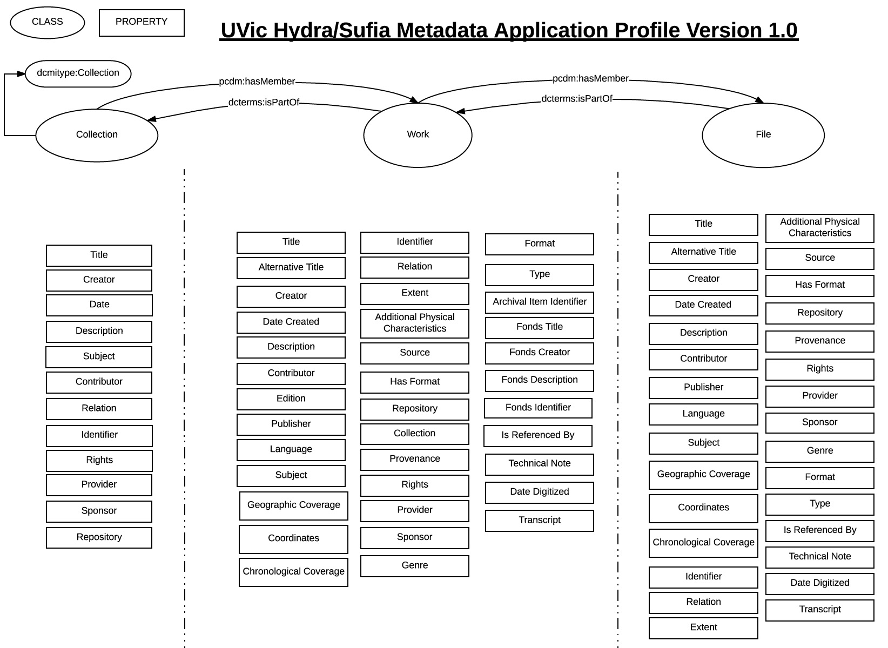
Metadata Consulting
Notes:
A final service that really helps to support digital preservation is metadata consulting. Our cataloguing experts can recommend data models and vocabularies that can improve the flexibilty and interoperability of your project data. They can also ensure that your project is capturing the information necessary for long term preservation.

Slide 18
Metadata Consulting
In-kind value:
$1500 ($65 x 25 hrs) for initial data modelling and metadata consultation.
Extended metadata services available at cost.
Notes:
Our library is offering each project 25 free hours of metadata consultation which can also

Slide 19
Strategic Alignment
DIGITAL HUMANITIES
LIBRARIES
Research Expertise
Discipline Knowledge
Content Expertise
Student Relationships
Funding Opportunities
Collection Building
Enhanced Description
Discovery Tools
Open Access
Digital Preservation
Unique Collections
Metadata Expertise
Physical Space
Permanent Staff
Long Term Stability
Notes:
Libraries and the Digital Humanities have many common objectives and interests, and also complementary skill sets that we can bring to bear on those goals. In order to realize the full potential of these partnerships we need ongoing conversations. The UVic Grants Menu is one attempt to spark those conversations early on in project design.

Slide 20
Thanks. lgoddard@uvic.ca

